Slide 1
Federal university dutse Faculty of computing department of computer science design and implementation of poultry management system fatima hussain hussain fsc/csc/14/0024
Supervisor
Malam Abdulazeez Yusuf

Slide 2
Problem Statement
Manual approach of keeping farm records…
Time consuming
Information easily misplaced
Difficult to monitor the state of the birds

Slide 3
Aim and objectives
AIM:
To develop a poultry information management system
Objectives:
Develop a database application for saving information
Facilitate update of poultry farm records
Presentation of reports

Slide 4
Scope and limitation
This research work covers Design and Implementation of a poultry information management system.
However It is LIMITED to recording information concerning birds only. Doesn’t include livestock

Slide 5
Literature review
S/N | Authors name & year | Title of work | Method used | Strength of their work | Weakness of the work
1. | Poultry housing and management in developing countries | Bell and Weaver (2010) | Qualitative method (interview) | The aim of management information system for the poultry farm is to provide the conditions that ensure optimum performance of the birds | Does not point out a computerized management system
2 | Poultry lighting: the theory and practice | Hogue and Morris (2013) | Quantitative method (survey) | To avoid diseases outbreak in birds production proper management, sanitation as well as essential vaccination schedule should be complied | The paper does not highlight an information system for keeping record of their medication

Slide 6
Literature review
S/N | Authors name & year | Title of work | Method used | Strength of their work | Weakness of the work
3. | Patrick Appiah 2010 | Assessing Farm Record Keeping Behavior among Small-Scale Poultry Farmers in the Ga East Municipality | Quantitative (survey) | The reason why most of the farmers did not keep all the farm records was because they assert that those records were not beneficial to them | Proposed a paper based system which is in efficient
4. | Becca Dikeman | Developing Product Lotting and Coding Systems for Small Meat and Poultry Processing Operations | Quantitaive (Interview) | The coding system gives a unique way of identification for different kinds of birds | Even though a unique way of identification is made. It still doesn’t highlight a computerized way of record keepin

Slide 7
Literature review
S/N | Authors name & year | Title of work | Method used | Strength of their work | Weakness of the work
5. | Varvarigos P. 2014 | An Inexpensive Microcomputer Based Data Record-Keeping System for the Individual Fish Farm | Qualitative (interview) | To minimise collection time and errors, a microcomputer based system was tested which recorded environmental and stock data in a standard form presenting the results in a daily, or weekly format, as required, with all arithmetic calculations completed by the computer. | Proposed is desktop based application, which can not be accessed over the internet

Slide 8
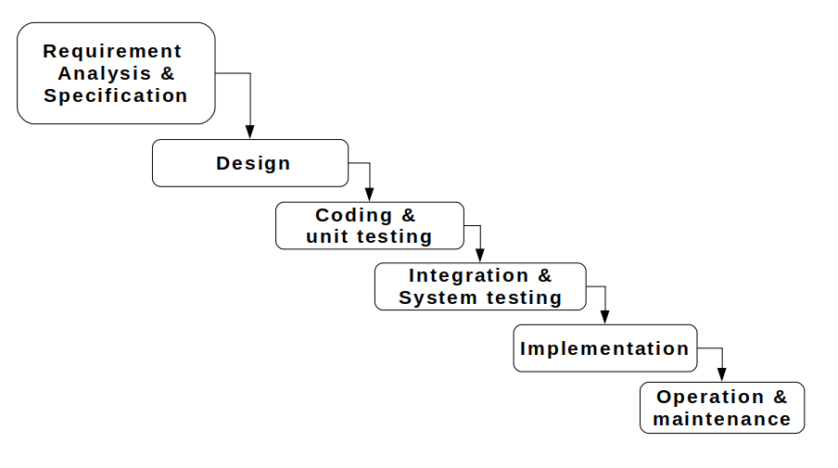
Methodology
Waterfall model
Sequential approach to software development

Slide 9
System testing
Unit testing: features of the system treated as units, developed and tested individually
Integration system: different units integrated into whole, tested to ensure they work proper
System testing: testing the operation of the finished project

Slide 10
Conclusion
Manual method of record keeping is proved to be inefficient due to loss and damage of information. However the system developed as part of this project will overcome the issue of the traditional method by providing a more efficient and consistent way of poultry records.

Slide 11
THANK YOU

